Slide 1
Analysis of Pooling Layers on CNNs
Nick Fogg, David Sweasey
4/19/24

Slide 2
Background - CNNs
Most popularly used in image recognition and classification
Pixel data in image saved as arrays dependent on resolution
Height x Width x Dimension
Input Processing Classification

Slide 3
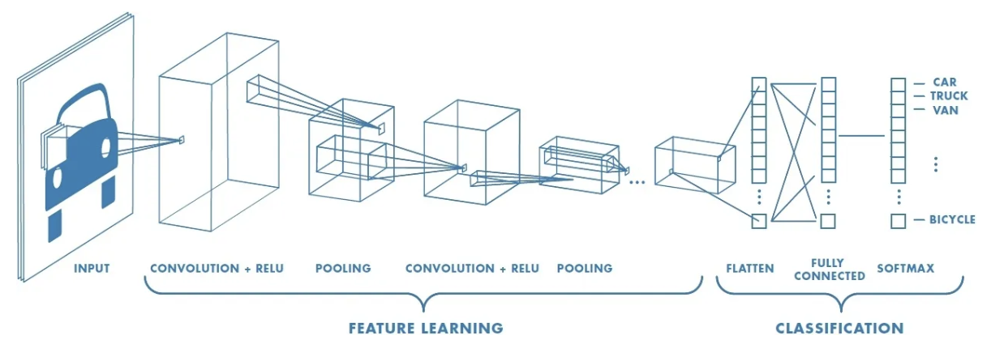
Background - CNNs
Notes:
Convolution Layer: Extracts features from an image, preserving pixel relationships using a filter matrix.
Image matrix is multiplied by filter matrix to create a Feature Map.
Different filters create different convolutions. Certain filters can perform operations like detecting edges, sharpening, or blurring images.
The larger images matrices are compatible with smaller filter matrices due to strides and padding. Strides affect the pixel shift over the input matrix and padding wraps or drops the excess parts of an input matrix
ReLU (Rectified Linear Unit for a non-linear operation) cleans up real world data and deals with non linearity in values.

Slide 4
Background - Pooling Layers
Goal is to reduce the spatial dimensions (height and width) of image
In turn reduces number of parameters
Reduce dimensionality while maintaining important features

Slide 5
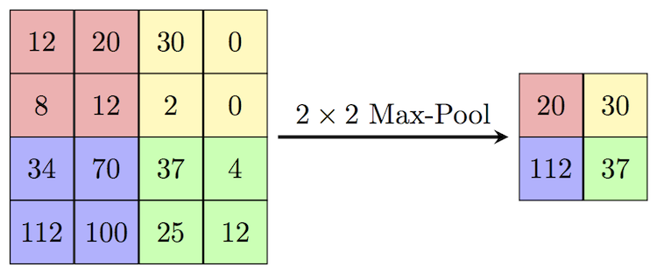
Background - Pooling Layers
Spatial pooling comes in many forms
Max, Average, Sum, Adaptive
Appropriate pooling depends on specific task and data
Notes:
Adaptive Pooling: pools features from all levels for each proposal. An algorithm pools feature grids from each level. A fusion operation like typical max, average, or sum is then used to condense the matrix.

Slide 6
Motivation
The accuracy of CNNs is paramount
Pooling layers are an important part of this
We want to maximize speedup, minimize overhead, and ensure accuracy
Notes:
CNNs are used in many real-world applications, such as medicine and facial recognition.
Pooling layers help reduce computational complexity and reduce overfitting. However, because they decrease the size of the input data, important data could be lost. We want to explore which pooling approaches are most effective for speed, reducing overhead, and accuracy. See how different approaches work across different data sets

Slide 7
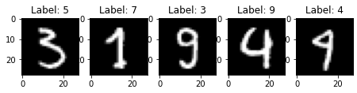
Experiments (planned)
Test performance of several pooling methods utilizing a PyTorch CNN
Assess using diverse image recognition datasets
What is optimal pooling method for this problem?
What trends are present between pooling methods?

Slide 8
Related Works
Pooling in Convolutional Neural Networks for Medical Image Analysis
On the Importance of Pooling Layer Tuning for Profiling Side-Channel Analysis
Notes:
The first analyzes performance of various pooling methods on medical image datasets. It reveals that for any given dataset, there tends to be a specific pooling method that is most effective. However, a combination of multiple approaches can yield a happy medium that is general enough to perform well on many datasets.
The second reveals similar results. For the best results, pooling layers must be chosen and tuned specifically to a dataset.

Slide 9
References
Saha, S. (2022) A comprehensive guide to Convolutional Neural Networks - the eli5 way, Medium. Available at: https://towardsdatascience.com/a-comprehensive-guide-to-convolutional-neural-networks-the-eli5-way-3bd2b1164a53 (Accessed: 21 February 2024).
Nirthika, R., Manivannan, S., Ramanan, A., & Wang, R. (2022, February 1). Pooling in Convolutional Neural Networks for Medical Image Analysis: A Survey and an empirical study - neural computing and applications. SpringerLink. https://link.springer.com/article/10.1007/s00521-022-06953-8#Tab6
Wu, L., Perin, G. (2021). On the Importance of Pooling Layer Tuning for Profiling Side-Channel Analysis. In: Zhou, J., et al. Applied Cryptography and Network Security Workshops. ACNS 2021. Lecture Notes in Computer Science(), vol 12809. Springer, Cham. https://doi.org/10.1007/978-3-030-81645-2_8
Wikimedia Foundation. (2024, April 2). MNIST database. Wikipedia. https://en.wikipedia.org/wiki/MNIST_database%C2%A0

Slide 10
Questions?

